Slide 1



DigiPack
Year 13
Lesson objective
What is included in my DigiPack?

Slide 2



Coursework Briefs
Film
Music
Music Promo Video
Magazine Advertisement
CD/DVD cover
Film
Film trailer
Film magazine front cover
Film poster
TV
Soap Trailer
Front cover TV listings magazine
TV Soap poster

Slide 3
Digipak: What’s the point?
Synergy
CD/DVD
Music/film/TV Video
Album/Magazine Advert

Slide 4




Slide 5
What do you see?
Name of artist
Name of album
Reviews
Stars
Date
Record label
Sponsors
Where can you buy it?
Images of artist?

Slide 6

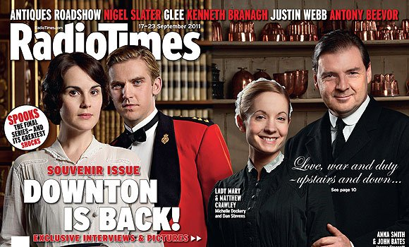

Slide 7

Key terms
Offer
Headline
STRAPLINE
Competition
MASTHEAD
Web address
MAIN IMAGE/
FOCAL POINT
Stars
LEAD STORY
Banner
Competition
Advice
Shock
Feature
Price
Pug
SELL LINES
Exclusive
Barcodes

Slide 8


Slide 9
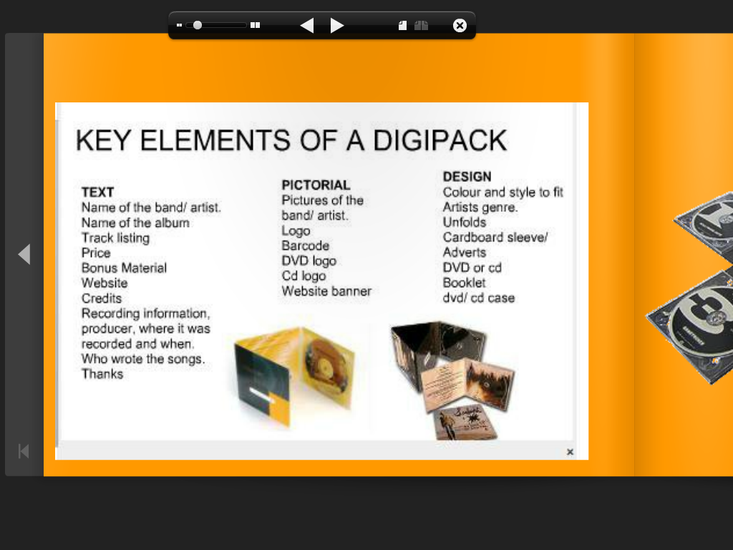

Slide 10


Slide 11
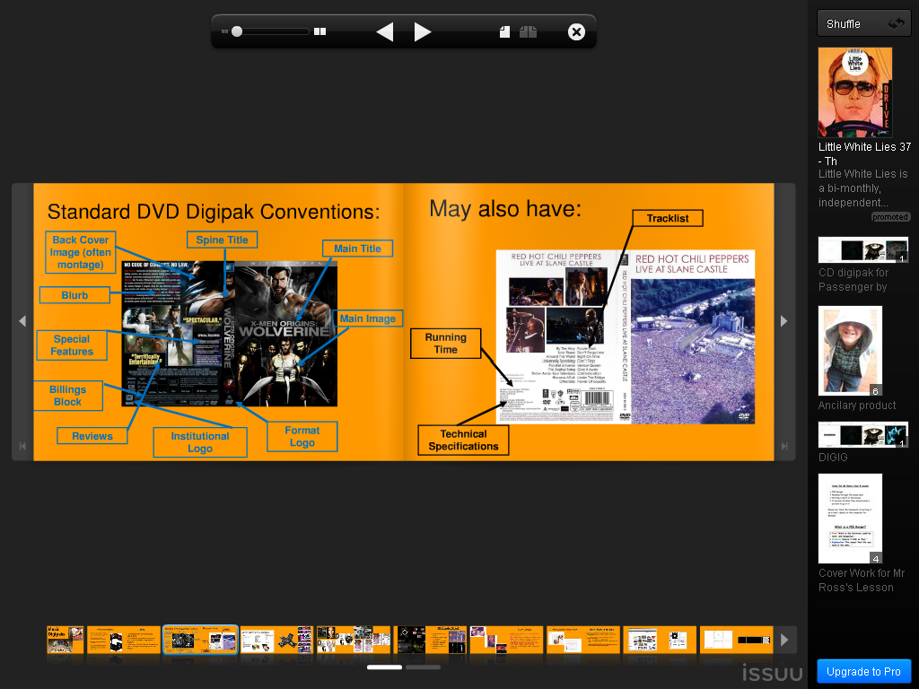

Slide 12
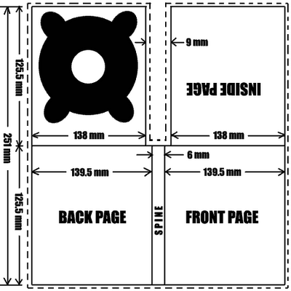

Slide 13
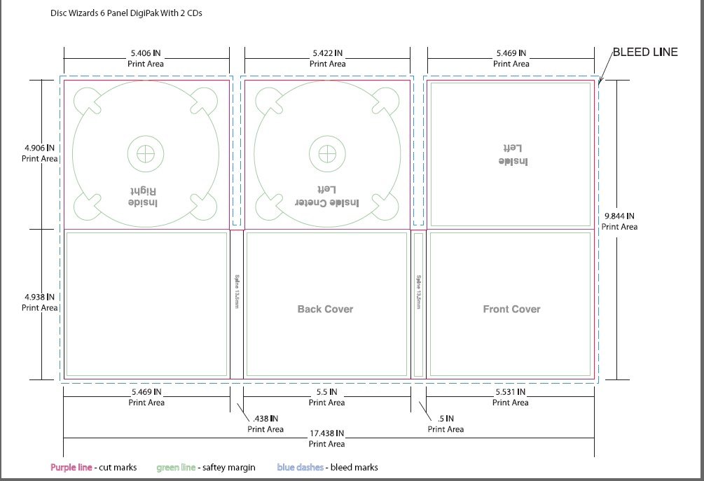

Slide 14
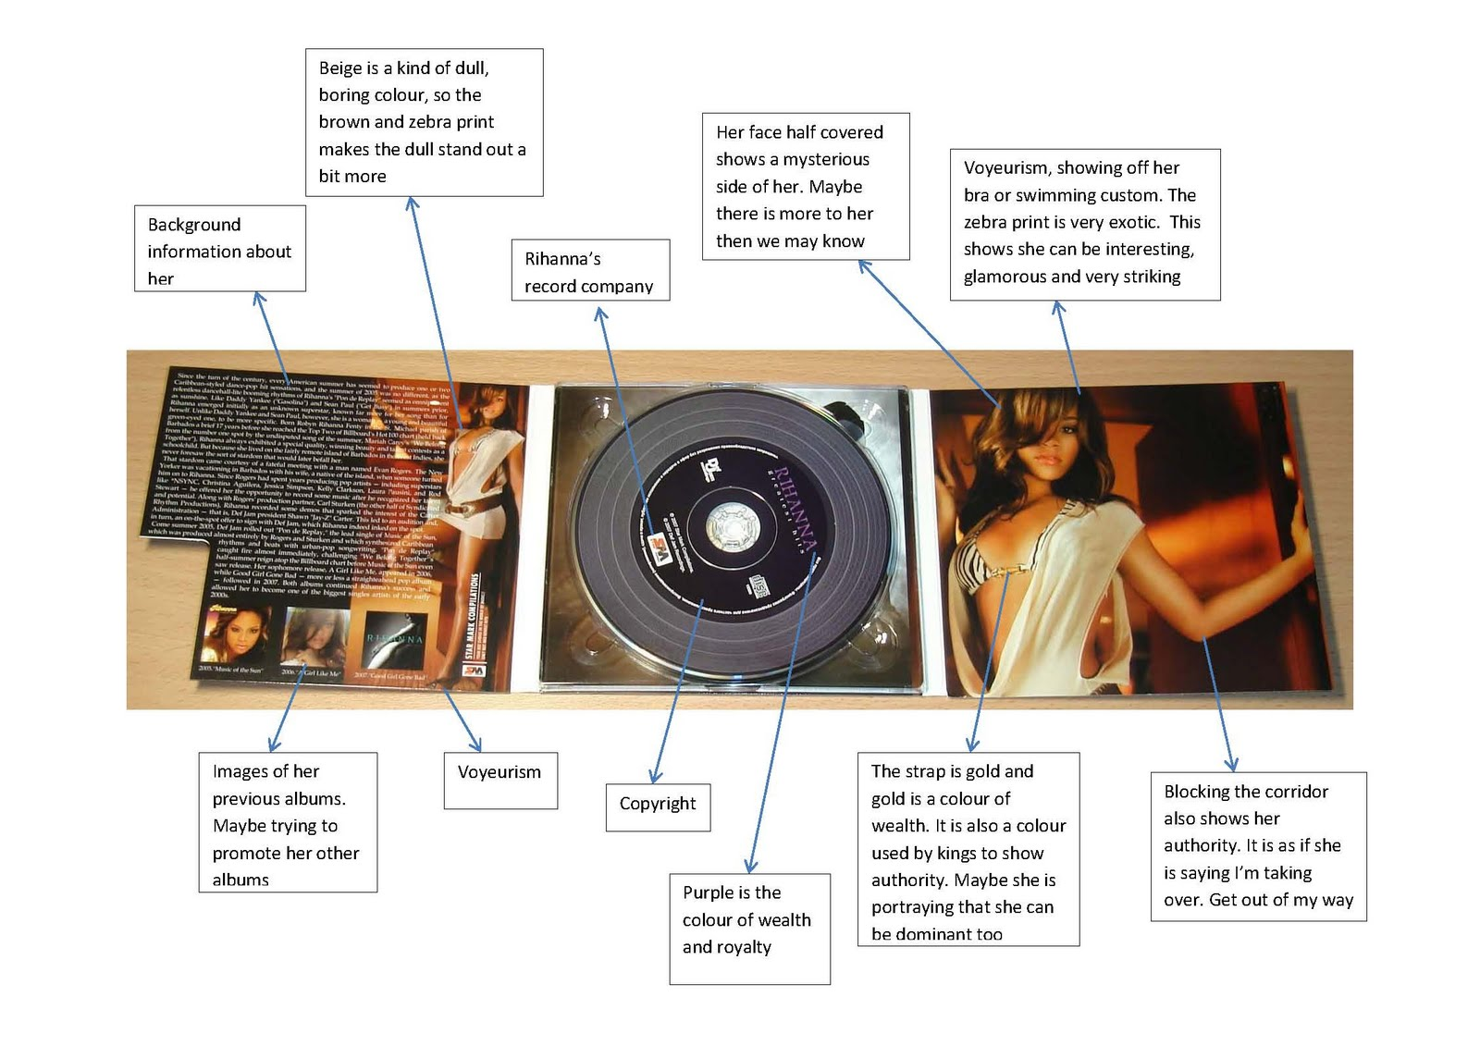

Slide 15




